Slide 1

Key Club Meeting
September 7, 2018

Slide 2

WHAT IS KEY CLUB?
World's OLDEST and LARGEST student-led service organization for high school students
Partnered with PTP, Eliminate Project, UNICEF
Teach core values: L I C C
INTERNATIONALLY recognized with 5,000 CLUBS and over 270,000 MEMBERS worldwide in over 38 COUNTRIES
Notes:
Allyson

Slide 3


PLEDGE
I pledge, on my honor, to uphold the Objects of Key Club International;
to build my home, school, and community;
to serve my nation and God;
and to combat all forces which tend to undermine these institutions.
Notes:
Allyson

Slide 4

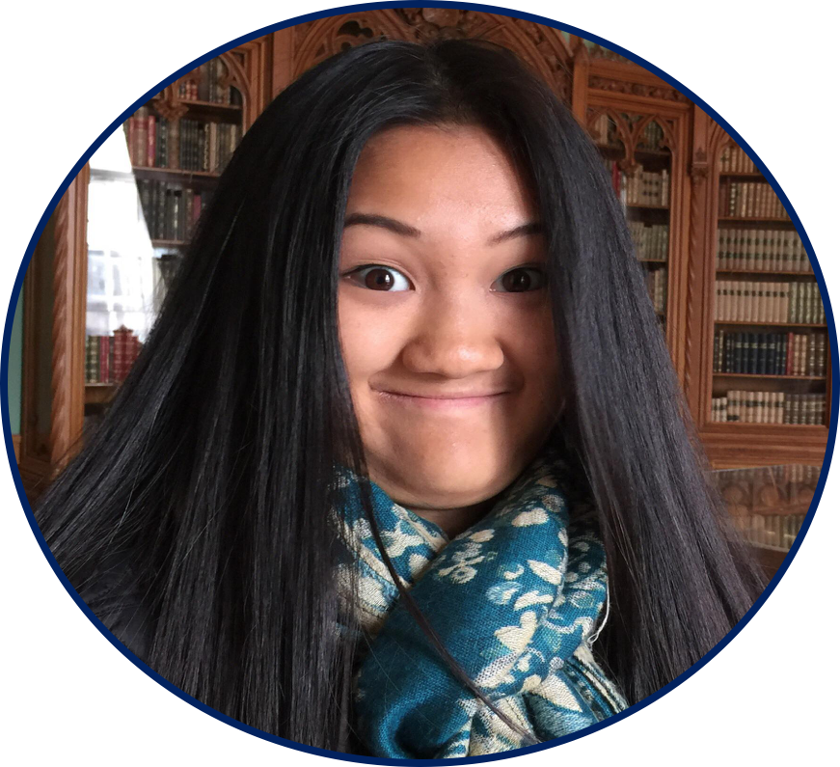
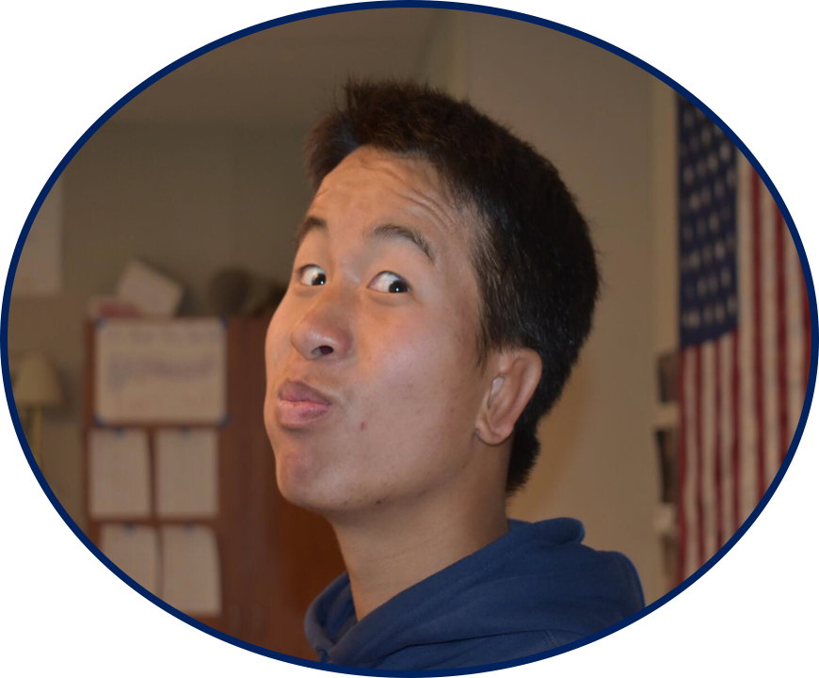
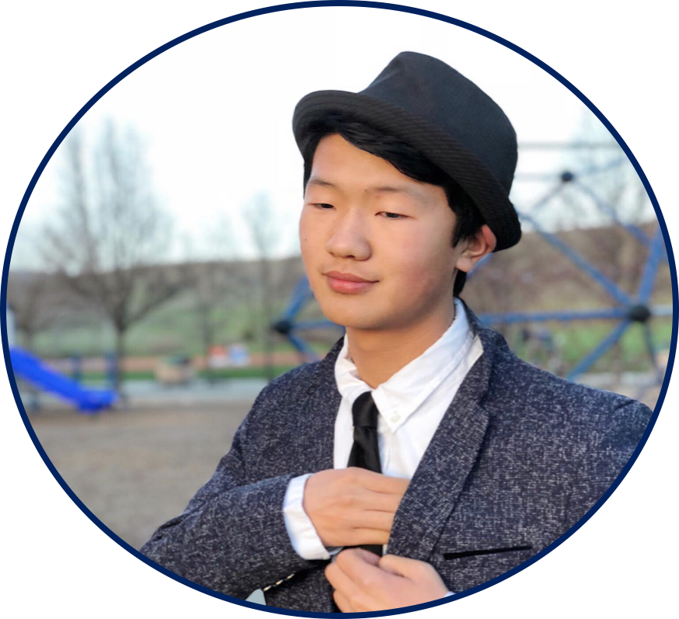
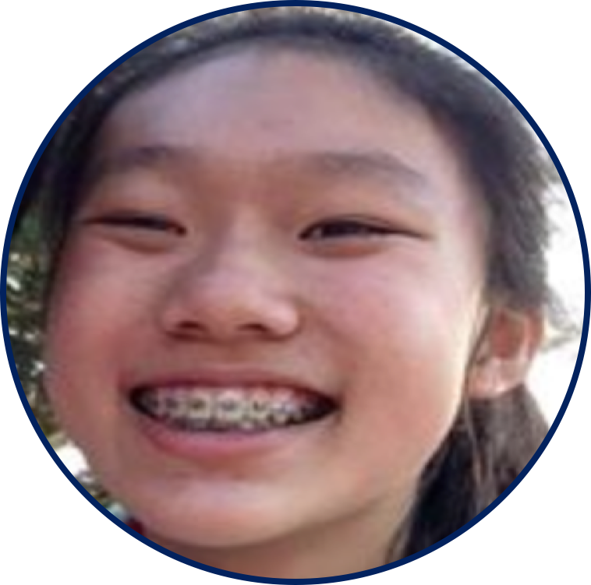
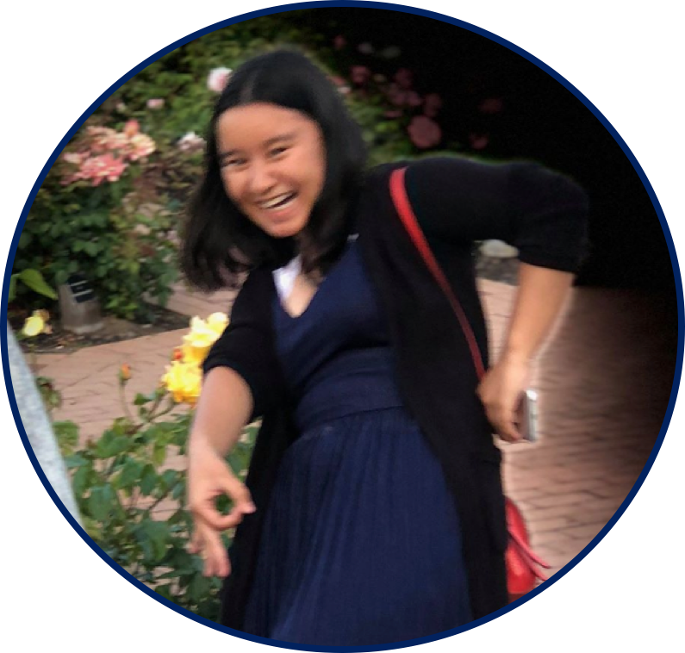
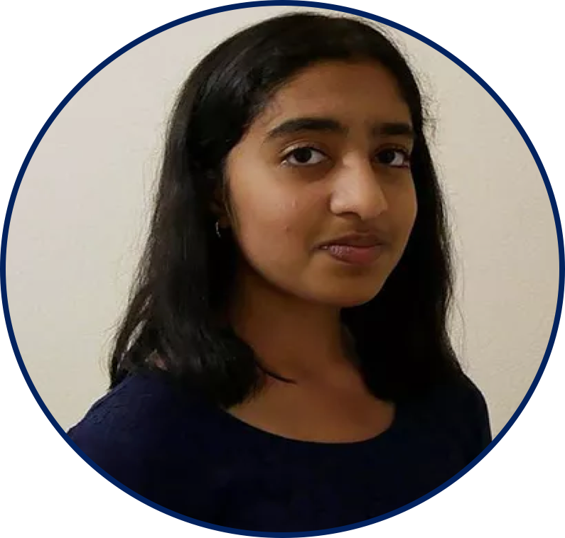
Meet Your OFFICERS
Co-Vice President Andrew Cheng
Co-Vice President Kevin Fang
President Allyson Wu
News Editor Caroline Lobel
Secretary Joyce Wu
Treasurer Aditi Raju
Notes:
Allyson: Introduce Committee

Slide 5
WHAT MAKES US DIFFERENT?
Student-led from top to bottom
Colleges know who we are and what we stand for
Get to meet people from all over the country
Huge variety of service events
  We provide service events for members EACH WEEK!
Large emphasis on leadership
  Learn skills that can help you become a better leader to help you in the world beyond high school!
Get to participate in team bonding/social events such as Fall Rally North, Region Training Conference, and more…
Notes:
Andrew

Slide 6






KEY CLUB STRUCTURE
School Club:
DVKC
Division:
26 South
Blue Devils
District:
CNH Bees
Region: 9
Key Club International
Notes:
Kevin

Slide 7
Membership Requirements
Obtain 10 service project hours before the end of the semester
Attend ALL general meetings (2 each month)
Attend at least 2 DCMs before the semester ends
Submit articles and visuals to get hours
  Maximum 2 hours per semester for articles and visuals (send to Caroline Lobel)
We occasionally offer hours for bringing supplies/help craft materials
Notes:
Caroline
2 visuals, candids, 1 article, as short or as long as you want
The event: Who, what, when, where; what you learned/any key club memories made
Message me for any questions

Slide 8
ACTIVE MEMBERSHIP RECOGNITION
10 hours per semester; at least 7 from Key Club
Attend 1 DCM (Division Council Meeting)
Attend all club meetings (the first Friday of each month) with the exception of one unexcused absence
HIGHLY Recommended: Pay $20 membership dues
Notes:
Caroline
Emphasize that we dont require a signature form

Slide 9
WHERE DO DUES GO?
Key Club International
Membership Cards & Pins
Club Shirts
Administrative Budgets
Officer & Board Budget( For Int’l President, VP, & Int’l Trustees)
Recognition Awards
International Convention
CNH District
Administrative Budget
Office & Board Budget (District Executives, Lieutenant Governors, District Committees)
Key Leader Discounts
Recognition Awards
Notes:
Aditi

Slide 10
OFFICIAL KEY CLUB MEMBERSHIP
Fill out form found in link on presentation
$15.00 membership dues paid to DVHS Key Club
  You will receive a pin, member handbook, and a membership certificate
Final Deadline: November
  If you turn it in early, you will receive free pizza and a chance to win a T4 gift card (two will be given out; $20 and $5)
Forms and dues to Ms. Amini’s room, Room 1118
If you have trouble paying dues, contact us and we will provide financial assistance!
Fill out form attached here (form will also be attached on Schoolloop)
$20.00 membership due paid to DVHS Key Club
  You will receive a Key Club pin, Key Club membership handbook, a T-shirt, and a Key Club membership certificate (new members only)
Early Bird Deadline: September 29th
    Turn it in at this deadline you will receive a chance to win a T4 gift card (two will be given out; $20 and $5)
  Regular Deadline: October 27th
    Forms and dues to Mrs. Lindgren’s room, Room 3105
If you have trouble paying dues, contact us and we will provide financial assistance!
Notes:
Aditi
Emphasize that you can still be a member without having to pay dues

Slide 11
BENEFITS OF MEMBERSHIP
Join the Key Club Ohana
Run for officer positions and comittee positions
Eligibility for contests, scholarships, and awards
  President’s Volunteer Service Award, Member Recognition Program, Cal-Nev-Ha Foundation Scholarships ($500-$2000)
Have your hours recognized for scholarships & awards
Attend events such as District Convention & International Convention
* Note that you do not have to pay to be a Key Club Member
Notes:
Andrew

Slide 12
MONTHLY EVENTS
DCMs (Division Council Meetings)
The entire division meets up every month for fun, socializing, and bonding as a group. After division updates are mentioned, a fun event, such as a movie night or a sushi date or a boba fest, is held.
DWSs (Division-Wide Service)
During a DWS, members from any club in the division participate in a service project together. This is a great way to bond with other members while serving the community!
Notes:
Andrew Cheng

Slide 13
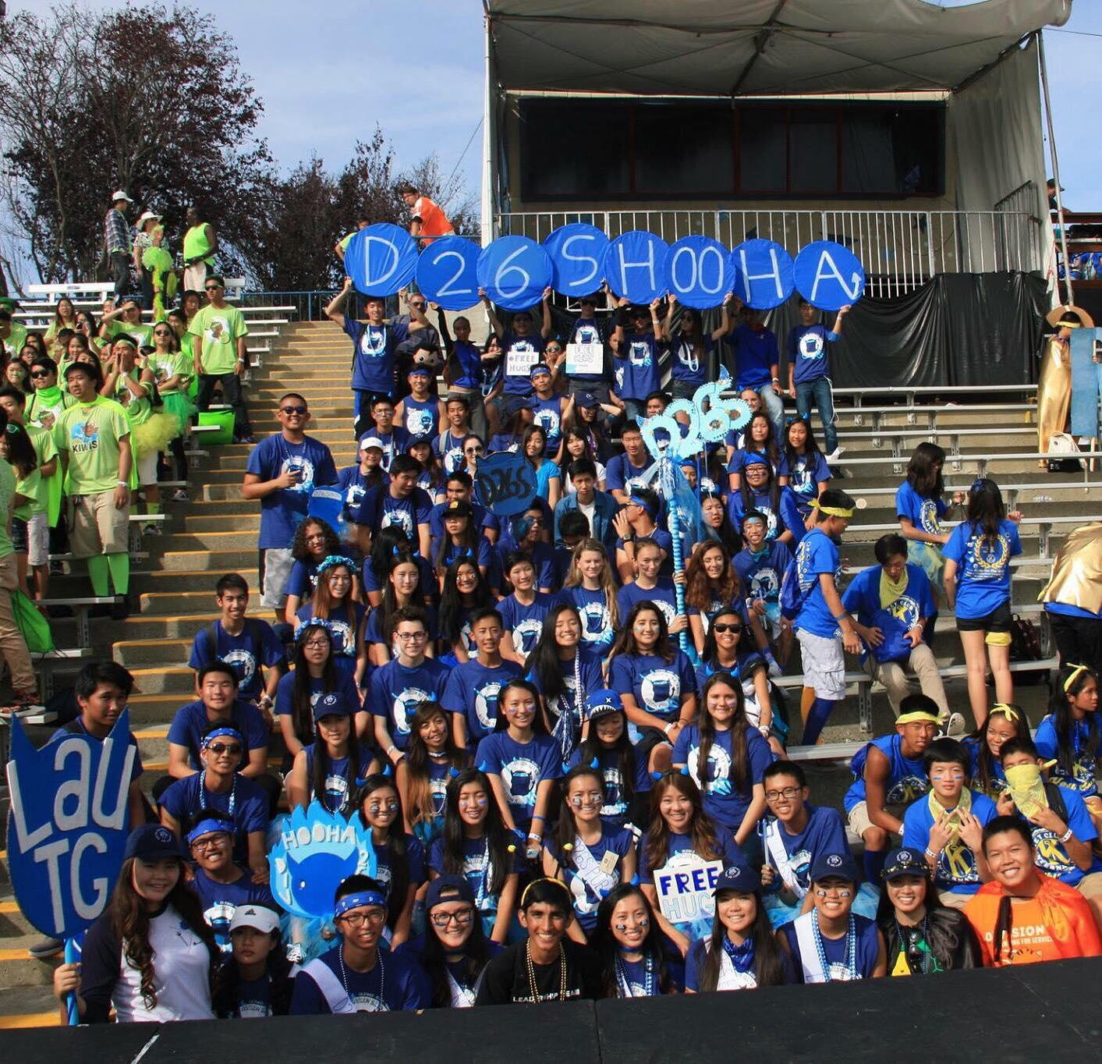
FALL RALLY NORTH (FRN)
WHEN | Saturday, Oct. 20 | ALL DAY
WHERE | Six Flags Discovery Kingdom in Vallejo
WHAT | Participate in the Divisional Spirit Rally, meet new people, help out the Pediatric Trauma Program, and show off your Key Club Spirit
COST | Pre-sale: $34, On-site: $38
Notes:
Joyce

Slide 14
FRN Requirements
New members must complete five (5) service hours* by October 13, 2018.
Returning members (any member that participated LAST YEAR) must complete ten (10) service hours* by October 13, 2018.
All attendees must attend at least one (1) spirit social event.
All attendees must attend at least one (1) Division Council Meeting. This can include the Spirit Social DCM.
All attendees should attend at least one (1) Division Council Meeting. This can include the Spirit Social DCM.
Notes:
Joyce

Slide 15
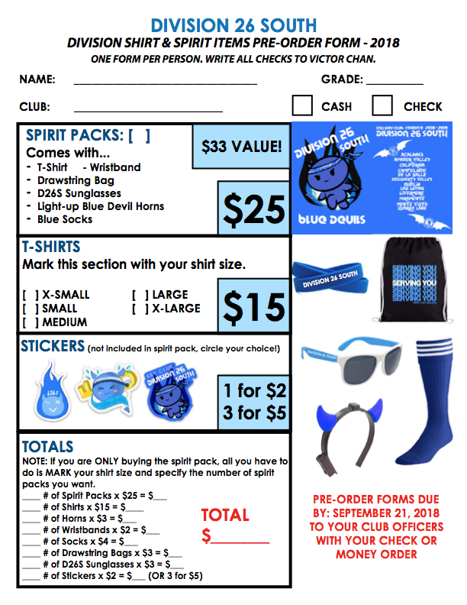
Division Spirit Pack
Deck out for FRN with these spirit items! Spirit pack items are worn and used by Fall Rally North attendees and any Division 26 South member that would like to purchase. This is also a Pediatric Trauma Program fundraiser! Please turn in your form to a club officer by September 21, 2018. No exceptions!
Notes:
Joyce

Slide 16

UPCOMING EVENTS
Eat Real Festival 2017
When | Saturday, September 15th, 9AM-9PM *shifts FULL*
Where | 55 Harrison St, Oakland, CA 94607
What | You will be acting as festival ambassadors answering questions, providing directions, and acting as alcohol control points, pointing out to attendees where our permits allows them to drink.
Notes:
Kevin - brush slides 15 + 16 +17 +18

Slide 17

UPCOMING EVENTS
Culture in the Community - Celebration San Ramon
WHAT | Help our city to celebrate diversity at the Community Center, and help to run games, booths, and much more! Save the date!
WHEN | Sunday, September 16th *SHIFTS FULL*
WHERE | San Ramon Community Center
Dublin Splatter Festival
When | September 15th, 11:15 AM-8:45 PM *shifts will vary*
Where | Emerald Glen Park
What | There will be multiple shifts for this event throughout the day, so be sure to save the date and earn plenty of hours! Members will have the opportunity to volunteer with the city of Dublin or help fundraise at the Dougherty booth!
Notes:
Kevin - brush slides 15 + 16 +17 +18

Slide 18
UPCOMING EVENTS
San Ramon Parks Make Life Better-September Edition
Join us for another round of cleaning up San Ramon’s Parks on September 15th! Be Sure to Save the Date!
WHEN | Saturday, September 15th, 9 AM-12 PM
WHERE | Memorial Park, 5001-5011 Bollinger Canyon Rd, San Ramon, CA 94583
**ONLY 4 SPOTS LEFT**
Please sign up online.
Notes:
Kevin - brush slides 15 + 16 +17 +18

Slide 19
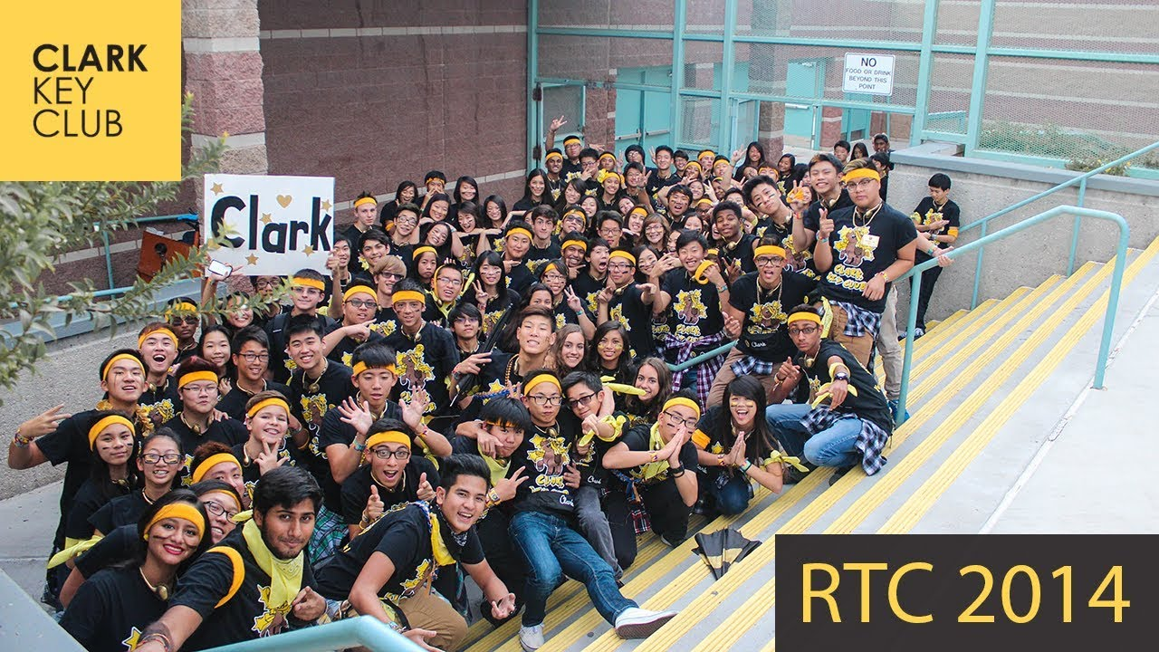
REGIONAL TRAINING CONFERENCE
In case you didn’t know, RTC stands for Region Training Conference! It’s an annual event for Region 9 and 17, composing of various workshops and fun activities.
This year, the RTC theme will be . . .
Olympians of Service! That means you will all have the chance to come on a Greek Mythology adventure this September, and join us for an educational and exciting conference.
Make sure you save the date
September 29th - 30th because that’s when RTC is taking place. Please spread the word about RTC!
Notes:
Kevin - brush slides 15 + 16 +17 +18
Anyone who is interested should talk to allyson after the meeting

Slide 20
NEXT MEETING
Date: FRIDAY, September 21st during lunch in the Aux. Gym
Our meetings will usually be every other 2 weeks on Fridays during lunch (location will vary)
Please check your emails at least once a week! PLEASE LET US KNOW IF YOU DO NOT RECEIVED EMAILS FROM US BY MONDAY!
If you wish to change your email or add your email to our mailing list, message one of us
Notes:
Allyson

Slide 21
SOCIAL MEDIA/CONTACT INFO
Club Contact Information
Facebook | Dougherty Valley Key Club
Email | dvhskey@gmail.com
Remind | TEXT “ @dvkc “ to 81010 or download the app!
Website | dvhskey.wix.com/dvkc
Facebook | Dougherty Valley Key Club
Instagram | @dvhskey ( WE FOLLOW BACK <3 )
* NEW! Discord | https://discord.gg/3cjrCbz
Notes:
Andrew

Slide 22
CONTACT US!
President: Allyson Wu Treasurer: Aditi Raju
allytang8436@gmail.com aditisanram@gmail.com
Vice Presidents:
Andrew Cheng News Editor: Caroline Lobel
andrew.cheng.dvhs@gmail.com carolinelobel12@gmail.com
Kevin Fang
kevinfang1098@gmail.com
(925) 364-1430
Secretary: Joyce Wu
wujoy707@gmail.com
Notes:
Andrew

Slide 23

BUZZING WITH SERVICE

